Slide 1
Core communication 3: Communicating remotely, SBAR communication and communication with the MDT

Slide 2
Learning outcomes
Interaction in a professional manner with a patient and members of the team (Interpersonal skills)
Communicate effectively using verbal, non-verbal, listening and writing skills via digital methods (inter-personal skills)
Reflect on practice and respond appropriately to feedback (professionalism)
Document your findings accurately (assessment treatment and management)
Formulate a problem list (clinical reasoning)

Slide 3

Communication
Why is effective communication important in physiotherapy ?

Slide 4

Communication
Fundamental to patient centred care:
  Understand a patient’s needs
  Understand a patient’s preferences and concerns
  Involve patient’s in decision making
  Tailor treatment plans to an individual
Create the therapeutic alliance:
  Build trust and rapport
  Build joint goals
  Collaborate problem solving

Slide 5
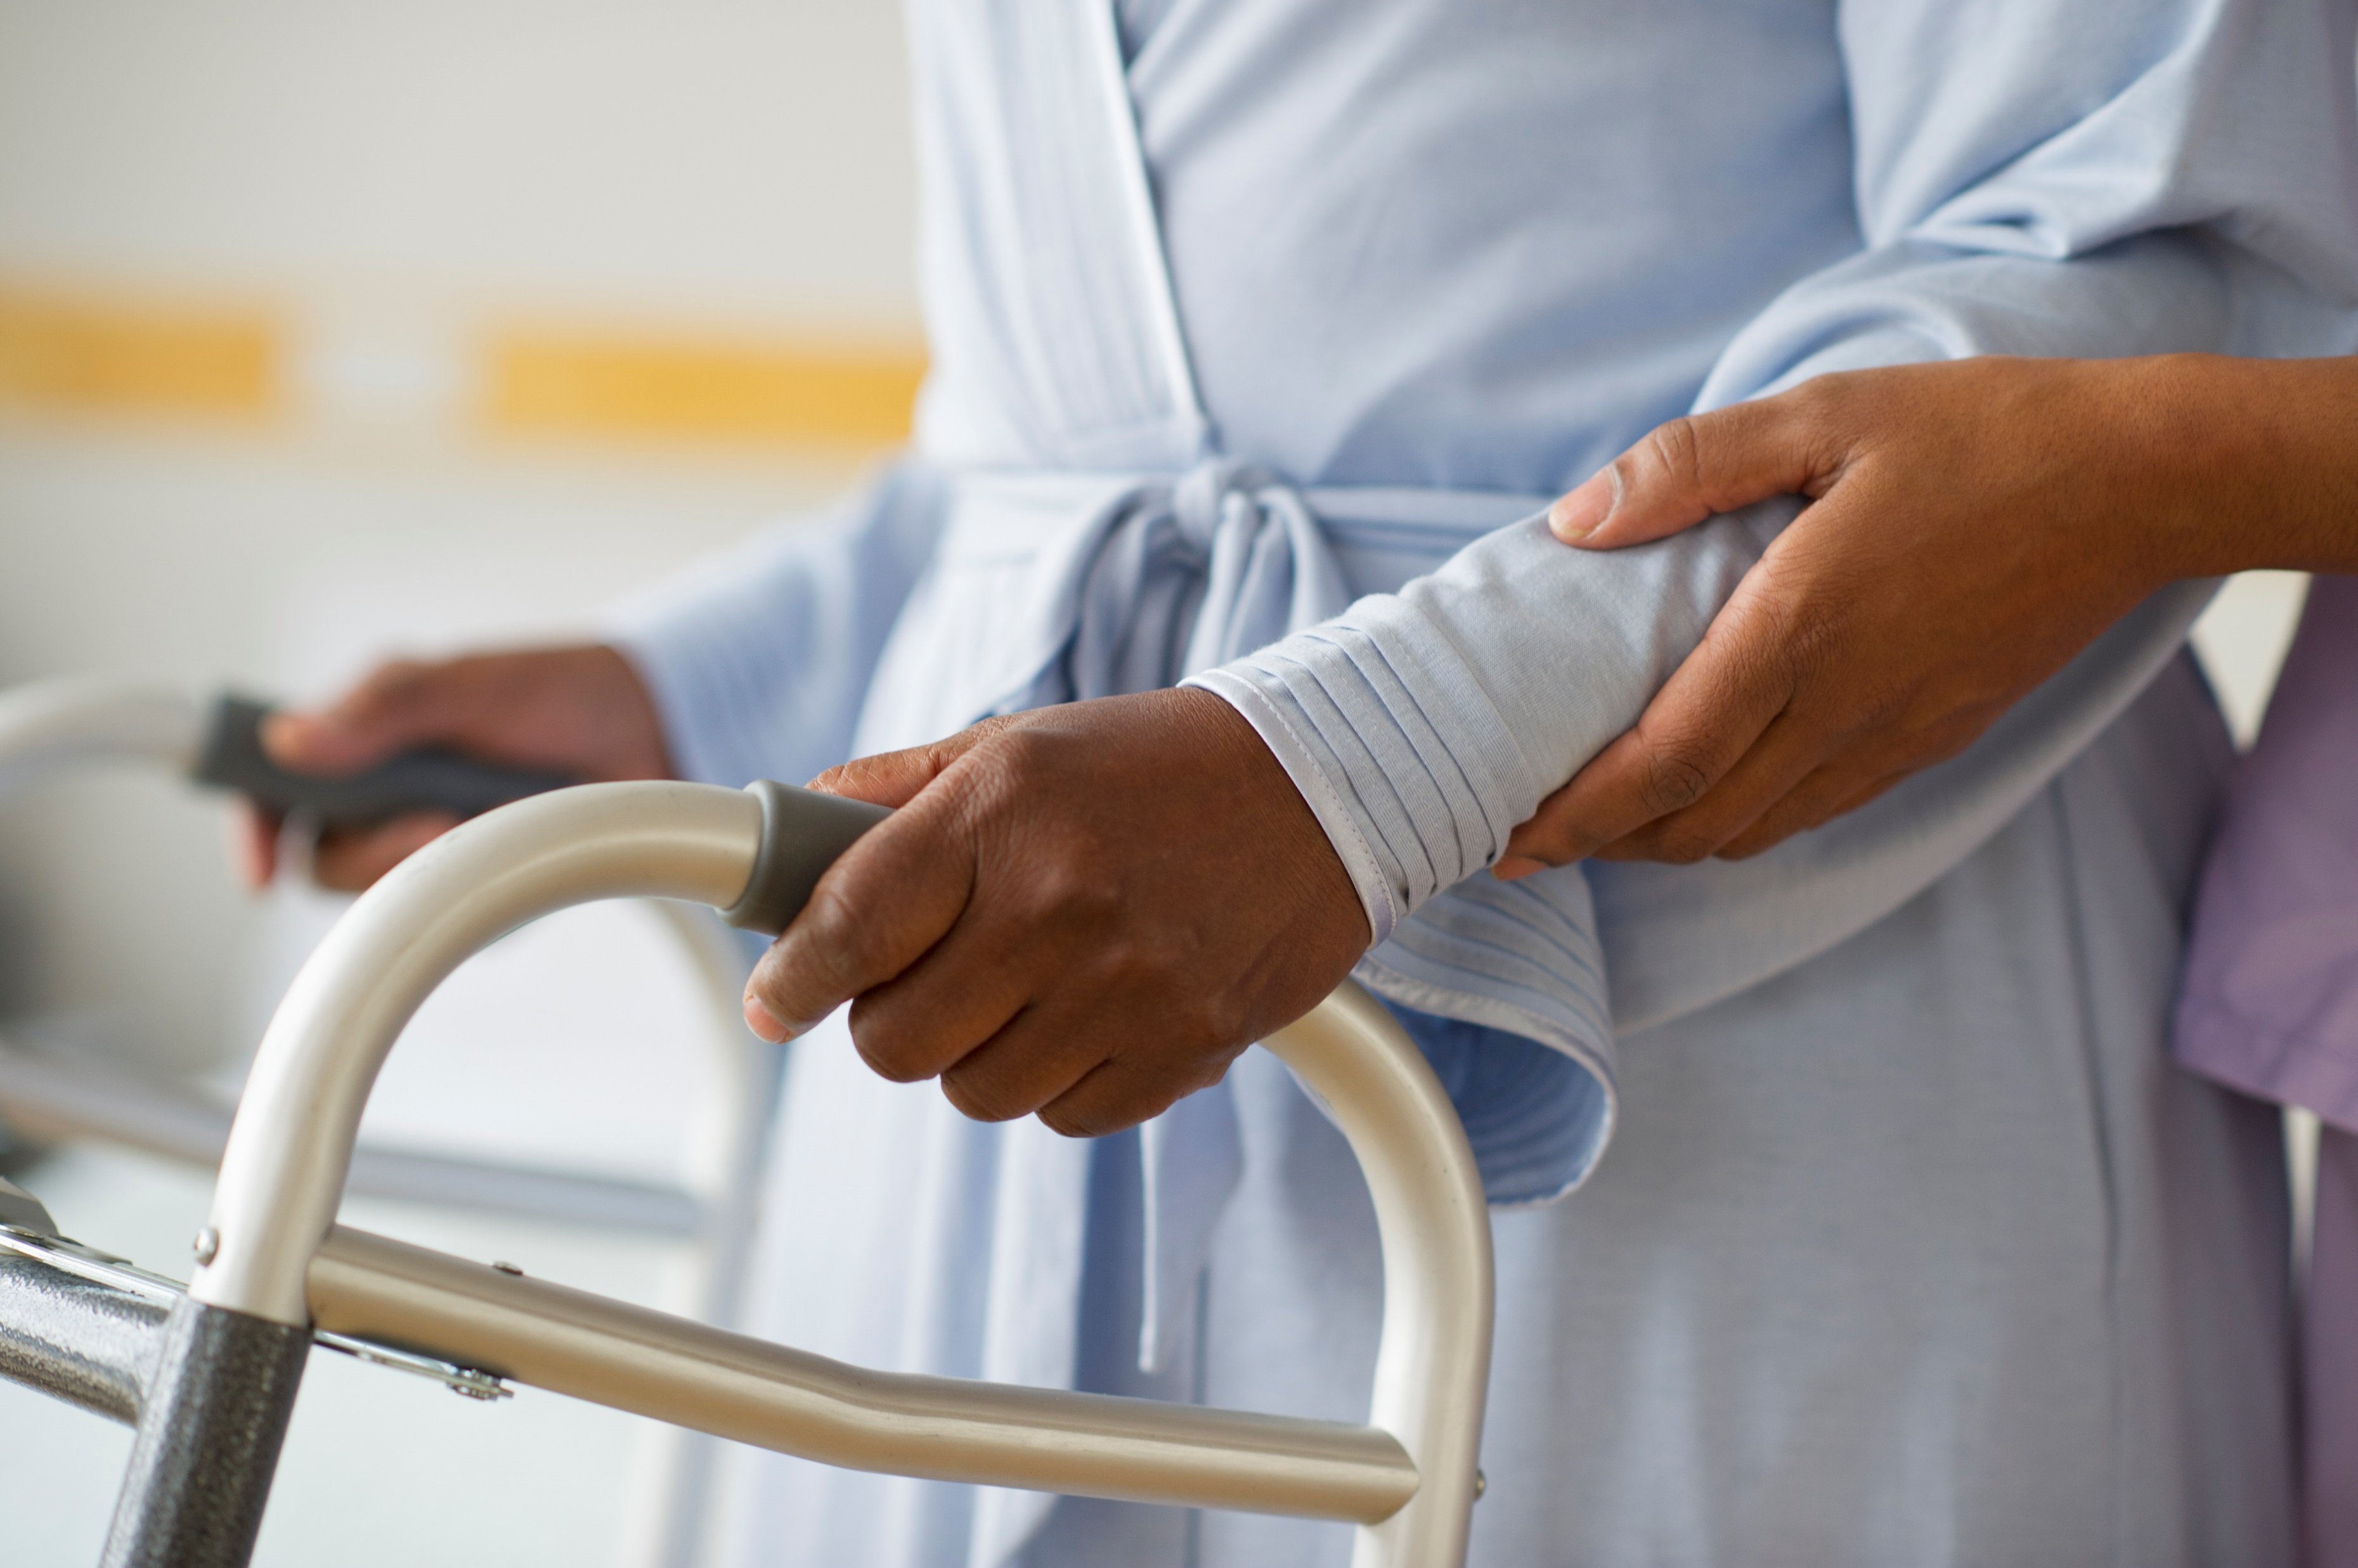
Communication
Enable patient education and empowerment:
  Give patients autonomy over their treatment choices
  Empower patients to take an active role in recovery
  Address misconceptions and alleviate fears
  Reduce patient anxiety

Slide 6

Communication
Interdisciplinary collaboration:
  Coordinate care
  Share critical or emergency information
  Ensure continuity of care
Patient safety and risk management :
  Prevent misunderstandings and errors
  Ensure we obtain informed consent
  Manage patient expectations
In line with HCPC guidelines:
  “Communicate appropriately and effectively”

Slide 7

Remote communication
A new challenge in physiotherapy
  COVID
  Advancement of technology
Virtual clinics
Remote reviews
Remote meetings and MDT sessions

Slide 8

CSP guidance
You should consider:
  The patient’s needs/ preference
  The patient’s clinical picture
    Be flexible around changing needs
  The communication needs of the patient
  The purpose of the consultation
  The resources available :
    To you
    To the patient

Slide 9

Communicating remotely
Examples where remote physio is already in place:
  MSK outpatient follow ups
  Post surgery follow ups
  Fracture clinics
  Respiratory outpatients:
    Breathing pattern disorder
    NIV clinic
  Exercise classes:
    Cardiac rehab
    Pulmonary rehab

Slide 10
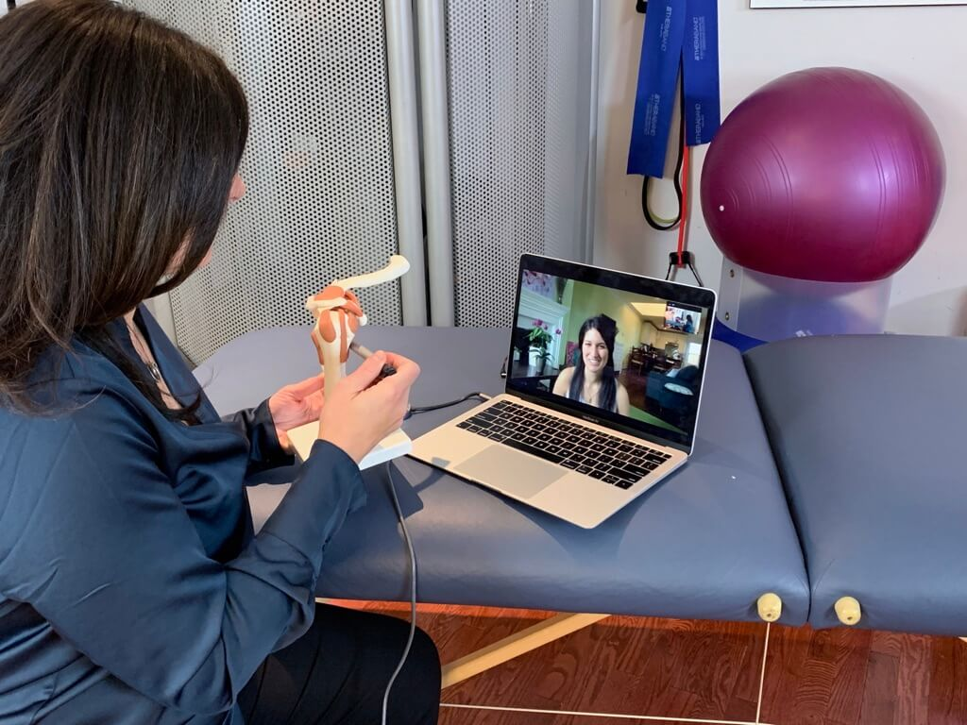
Pros of remote / virtual consultations
Improved access and convenience:
  Saves time and money
  Reduced disruption to pt day
  Enables faster access
  Improves access for some communities
Enhances patient experience:
  More flexibility and choice for the pt
  Reduced stress
  Can improve pt comfort
Improved service delivery :
  Supports flexible working
  Reduced community travel time
  Collaboration is easier
In line with digital innovations of NHS long term plan

Slide 11
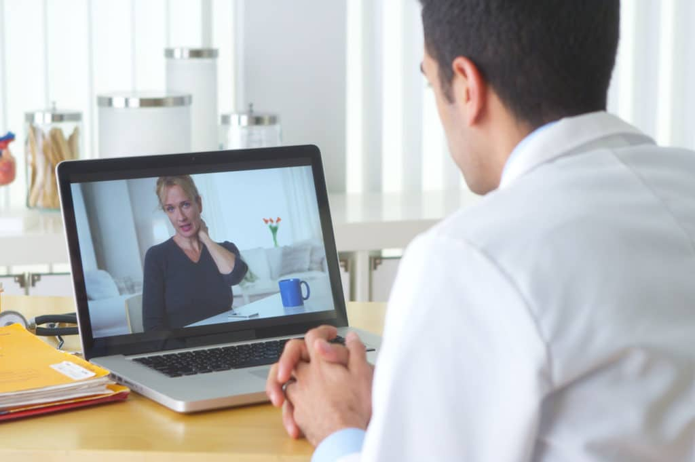
Cons of remote/virtual consultations
Clinical limitations
  May lead to delayed diagnosis or missed diagnosis
  Risk of over/ under investigation
  Compromised efficacy particularly in complex cases
  Potential overreliance on imaging
Communication challenges :
  Reduction in therapeutic relationship
  Missed opportunity to pick up non -verbal cues
  Potential miscommunication/ misunderstanding
Technological and practical issues
Impact on physiotherapists:
  Potential increase in stress and anxiety
  Risk of isolation
  Challenges in balance of work-life

Slide 12



Best practice : NHS, NICE, CSP and HCPC
Preparation and setup:
  Quiet, private and confidential
  Maintain professional attire
  Position yourself appropriately in front of the camera
Patient selection and triage :
  Ensure the patient is suitable for remote consultation
  Patient preference is also important
Clinical considerations:
  Remote consultations compliment in person reviews
  Implement safety netting
  Ensure that the medium is accessible for patients and provide extra input if needed e.g. pdfs, videos etc
Ethical and legal considerations:
  Adhere to the professional standards
  Ensure you gain consent
  Maintain confidentiality

Slide 13

Communicating with colleagues and the MDT

Slide 14
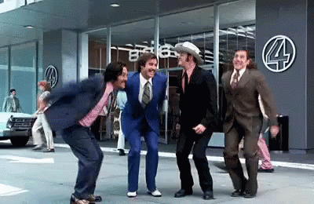
Communication with the MDT
Importance of MDT collaboration :
  Enhances understanding of each team member’s role and responsibilities
  Fosters trust and collaboration between diverse professionals
  Leads to more holistic and personalised care
  Reduces error and potential harm
  Improves resource efficiency
  Also one of the HCPC SOPs

Slide 15

Communication with the MDT
Lots of different mediums:
  In person
  Via email
  Via zoom
  On the phone:
    Pager or bleep system
    Deck phone
    Direct number

Slide 16
Emergency or urgent communication: SBAR
What is SBAR ?
Acronym : Situation, Background, Assessment, Recommendation
Structured communication technique for healthcare professionals
Why use SBAR?
Improves clarity and completeness of communication
Reduced errors in information transfer
Enhances pt safety and care quality
Facilitates effective interdisciplinary communication
Notes:
Originally developed in the US military for communication on nuclear submarines

Slide 17
SBAR : SITUATION
Briefly state the current situation or problem
  Who, What, When and Where
E.g. I’m Samantha a student physio calling from Cedar ward. I’m calling about Mr Smith a patient who’s blood pressure keeps dropping.
Situation
I am ( name and profession) on ward ( name)
I am calling about ( patient x)
I am calling because I am concerned that.... ( Spo2 dropping, Bp dropping )
Background
Patient ( X was admitted on ( date ) with ( PC)
They have had ( operation, procedure , intervention )
Patient ( x's) condition has changed in last ( x min)
Their last set of obs were ( xx)
Patient ( x) normal condition is .. ( alert/ confused ..)
I think the problem is ( XXX)
Or
Assessment
And I have .. ( given O2, done suction )
I don't know what's wrong but I am really worried
I am not sure what the problem is but patient x is deteriorating
Or
Recommendation
I need you to ..
Come and see the patient in the next ( xx mins)
AND
Is there anything I need to do in the mean time ? ( eg . Stop the fluid / repeat the obs/ give a nebuliser )

Slide 18
SBAR : Background
Provide relevant context and background
  The presenting condition of the patient
  Any procedures/ operations
  How the pt condition has changed
  Observations and outline how they differ from their baseline
E.g. Mr Smith came in for a heart operation 3 days ago. He has been having some low blood pressure when I stand him up. I measured his last blood pressure and it was 60 systolic. He was previously stable with no issues.
Situation
I am ( name and profession) on ward ( name)
I am calling about ( patient x)
I am calling because I am concerned that.... ( Spo2 dropping, Bp dropping )
Background
Patient ( X was admitted on ( date ) with ( PC)
They have had ( operation, procedure , intervention )
Patient ( x's) condition has changed in last ( x min)
Their last set of obs were ( xx)
Patient ( x) normal condition is .. ( alert/ confused ..)
I think the problem is ( XXX)
Or
Assessment
And I have .. ( given O2, done suction )
I don't know what's wrong but I am really worried
I am not sure what the problem is but patient x is deteriorating
Or
Recommendation
I need you to ..
Come and see the patient in the next ( xx mins)
AND
Is there anything I need to do in the mean time ? ( eg . Stop the fluid / repeat the obs/ give a nebuliser )

Slide 19
SBAR : Assessment
Share you professional evaluation of the situation if you can or share your concern/ worry
E.g. I mobilised with him yesterday and I am unsure what has caused this change in his blood pressure. It is not safe to mobilise him.
Situation
I am ( name and profession) on ward ( name)
I am calling about ( patient x)
I am calling because I am concerned that.... ( Spo2 dropping, Bp dropping )
Background
Patient ( X was admitted on ( date ) with ( PC)
They have had ( operation, procedure , intervention )
Patient ( x's) condition has changed in last ( x min)
Their last set of obs were ( xx)
Patient ( x) normal condition is .. ( alert/ confused ..)
I think the problem is ( XXX)
Or
Assessment
And I have .. ( given O2, done suction )
I don't know what's wrong but I am really worried
I am not sure what the problem is but patient x is deteriorating
Or
Recommendation
I need you to ..
Come and see the patient in the next ( xx mins)
AND
Is there anything I need to do in the mean time ? ( eg . Stop the fluid / repeat the obs/ give a nebuliser )

Slide 20
SBAR : Recommendation
State your suggestion for addressing the situation
Establish if there is anything you can do in the meantime
E.g. Please can you come and review Mr smith? Is there anything you would recommend I do whilst I wait for you ?
Situation
I am ( name and profession) on ward ( name)
I am calling about ( patient x)
I am calling because I am concerned that.... ( Spo2 dropping, Bp dropping )
Background
Patient ( X was admitted on ( date ) with ( PC)
They have had ( operation, procedure , intervention )
Patient ( x's) condition has changed in last ( x min)
Their last set of obs were ( xx)
Patient ( x) normal condition is .. ( alert/ confused ..)
I think the problem is ( XXX)
Or
Assessment
And I have .. ( given O2, done suction )
I don't know what's wrong but I am really worried
I am not sure what the problem is but patient x is deteriorating
Or
Recommendation
I need you to ..
Come and see the patient in the next ( xx mins)
AND
Is there anything I need to do in the mean time ? ( eg . Stop the fluid / repeat the obs/ give a nebuliser )

Slide 21
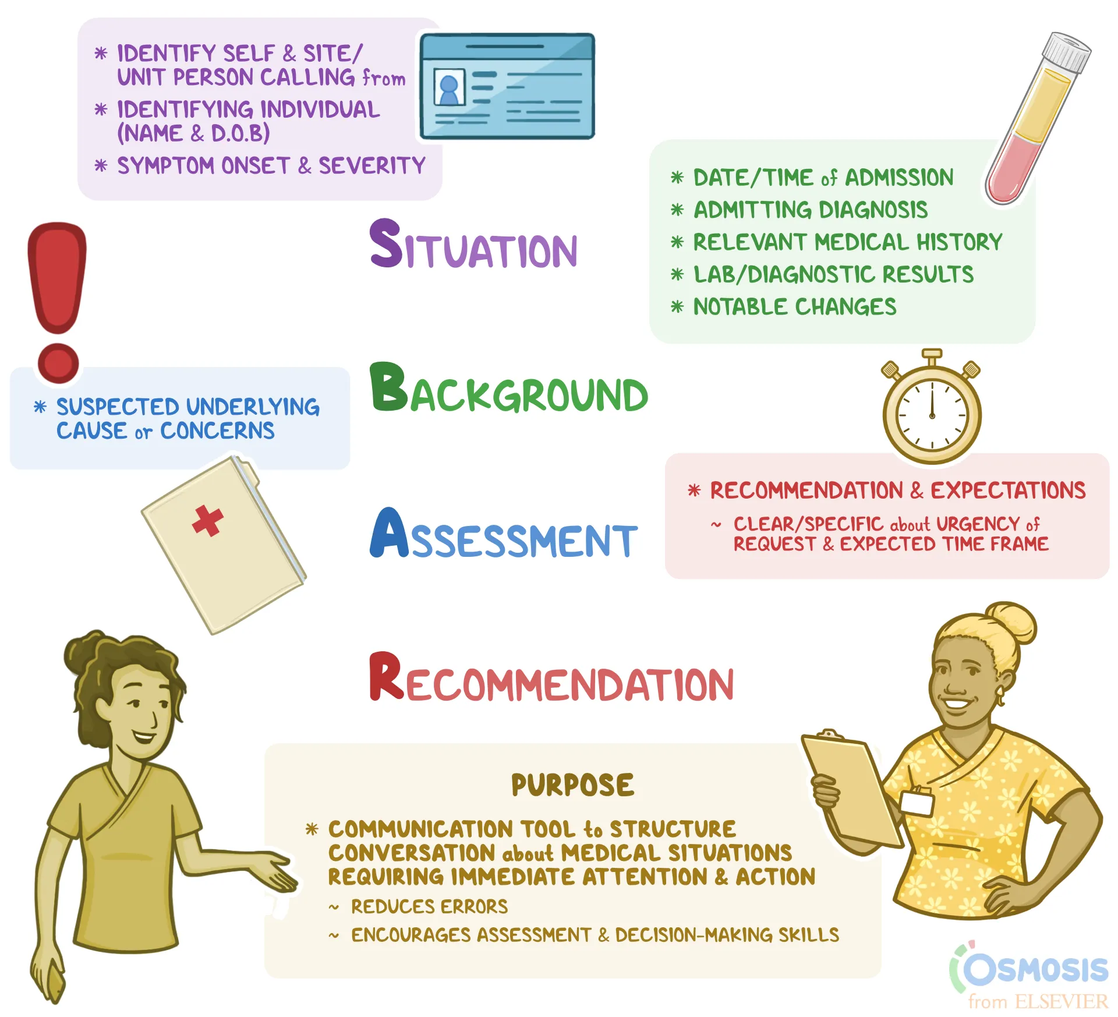
Now it’s your turn
Hand over this patient to your neighbour using SBAR:
Mr Brown, he is a day 1 post knee replacement. He’s been mobilising well but this morning has increased pain, his knee is also hot and very swollen. You are a student physio that was sent to review him for mobility and you are on the ortho ward 14G. You want the surgeon to come and review him urgently

Slide 22
SWAP OVER
Mrs Peterson is a stroke patient in room 415 on Tremblay ward. You are ringing the Occupational therapist because you want them to come and do a cognitive review. Mrs Peterson is confused and forgetful. She can’t recall your session from yesterday and her family have reported that she is more confused today after visiting.

Slide 23

Documentation
Clear documentation is key:
  Ensures good communication in MDT :
    Other physios
    Other professions
  Creates a log of what treatments you have completed
    Continuity of care
    Safety and risk assessment
    Protects you from legal issues
    Demonstrates and documents your clinical reasoning
  Part of your HCPC SOPs……
  Must be completed in 24 hrs

Slide 24
HCPC SOP
Standard 10 : Keep record of your work
  Keep full clear and accurate records for everyone you treat, care for or provide other services to
  Complete all records promptly and as soon as possible after providing care treatment or other services
  Keep records secure by protecting them from loss, damage or inappropriate access
Standard 2: communicate appropriately and effectively
Standard 7 : report concerns about safety
Standard 8 : Be open when things go wrong

Slide 25
SOAP NOTES
S : Subjective assessment
  Consent
  PC , HPC, PMH, MH, SH
  Any updates from you or the patient
O: objective assessment
  A:E assessment
  Risk assessment : how much help is needed for this patient , any special considerations.
  Special tests or outcome measures
Treatment section ( Rx )
  What you did in your session
A: Analysis
  Short summary of what you did/ found and any updates
  The clinical reasoning behind your treatment choices
P: Plan
  What you plan to do with the patient in your next session
  Any goals

Slide 26
Example
S: consent gained for treatment and assessment. Pt is day 1 post THR, reporting 3/10 pain. Eager to get up and go home. Medical team have no updates or plans, EDD: Friday am.
  SH: lives in a house with partner, 1 x flight of stairs. Previously some limitation with mobilising longer than 20 mins due to pain otherwise independent
O:
A: own, patent
B: Self ventilating (SV) on Room air (RA) Spo2 98% RR 12
C: Hr 60 Bp 120/80 (70) T 36.5
D: Alert
E: 1 x cannula in hand, no other attachments
Pt looks well, sat up in chair on approach

Slide 27
Example
Rx:
Sit to stand (STS) from chair Ao1 minimal
Mobilised 50m with WZF and So1, no loss of balance, no deviation in gait , no pain reported
Pt returned to bedside and left comfortable in chair with call bell in reach
A: pt is progressing well with mobility. Off baseline as mobilising with WZF, and requiring Ao1 to stand from chair. Pt lives with partner and previously independent. If no improvement by Friday will potentially require POC. Will require stairs assessment before discharge.

Slide 28

Example
P: Review again in the morning. Assess mobility and STS, progress to hand held Ao1 (HHAO1) from WZF. Complete stairs assessment
Goals:
  Mobilise 10m with So1 only 2/7
  So1 on 1 x flight stairs using single banister in 3/7

Slide 29
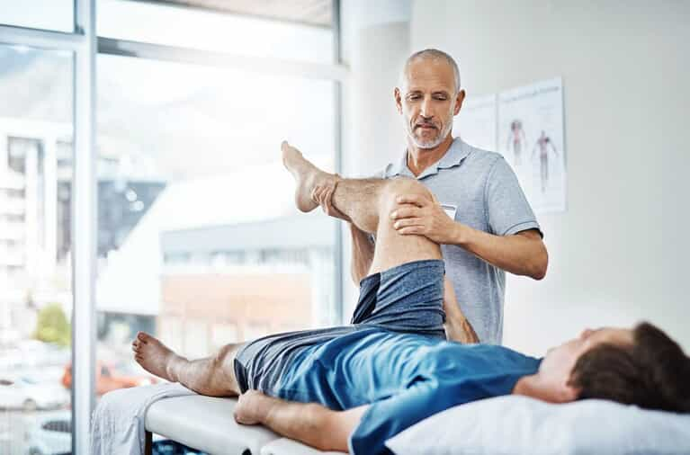
Creating a problem list
Forms part of your clinical reasoning and your assessment
Helps to organise your thoughts
Helps to identify your treatment goals
Guides your objective assessment choices

Slide 30
Creating a problem list
Should be created as soon as you receive the referral :
  When you read the written referral
  When you do your subjective assessment
  When you receive a handover from another member of staff
Briefly summarises the main problems with that patient
Should be in order of importance

Slide 31
Examples
Problem list :
  Reduced oxygen levels
  Thick sputum
  Weak cough
Problem list :
  Back pain for 3/12
  Struggling to sit for longer than 15 minutes
  Occasionally affecting sleep
Problem list:
  Weakness in upper limb
  Unable to complete fine motor tasks
  Anxiety about returning home
Problem list:
  Unable to mobilise independently
  Lives alone and has no support
  Has 3 flights of stairs

Slide 32
Your turn : create a problem list
You review Mrs Johnson in the ED after falling at home.
She has R hip pain and is not able to mobilise without 7/10 pain.
She lives alone and has 3 flights of stairs, she has one daughter who lives abroad. She has had 4 falls in the last 12 months and today was the first time she wasn’t able to get up by herself.
What is the problem list for this patient?

Slide 33
Your turn: Create a problem list
You see Sarah in your MSK clinic. She is a 35 year old office worker. She has had 6 months of lower back pain. The pain is worse when sitting and in flexion.
She has been avoiding the gym and has a sedentary job and has put on a bit of weight because of this.
She is having trouble sleeping because when she sleeps on her back she wakes up in pain.
She is stressed that she won’t be able to get back to exercise and that the pain will start affecting her job.
Create a problem list for this patient

Slide 34
Your turn: create a problem list
You review Max an 18 year old boy in your cystic fibrosis clinic.
They are due to transition into the adult clinic in the next 6 months and they are extremely stressed and anxious about this.
They have been struggling to complete their airway clearance consistently since they started revising for their exams. They have also struggled with keeping up with their gym routine due to increased Shortness of breath
Create a problem list for this patient

Slide 35
To finish off
Write a quick 5 minute reflection on communicating with the MDT
  Why is it important
  What strategies can you use
  How might you approach developing these skills for placement

